Slide 1


Cement Dispatch Optimization Using RFID and Sensor Data Analytics
PROJECT MANAGER
PREPARED BY Mr.BHARANI KUMAR DEPURU
CHANDRU A CEO-360DigiTMG

Slide 2
Contents
Business problem
Business Objective & Constraints
Project overview and Scope
Data Dictionary
Project Architecture - Data Flow Diagram
Data Collection and Understanding
Data Information
Technical Stacks
Exploratory Data Analysis
Data Visualization
Data preprocessing
Conclusion
Thank you
Notes:
Change

Slide 3
Business Problem
The cement manufacturing company’s dispatch process is currently inefficient due to delays in truck loading and unloading, manual record-keeping, and lack of insights from existing data. Although weighbridge measurements and dispatch logs are recorded, they are not analyzed systematically to understand performance patterns. This leads to longer truck turnaround times, suboptimal fleet utilization, and higher operational costs. Without analyzing this data, management cannot make informed decisions to streamline operations, reduce delays, or improve overall supply chain efficiency.

Slide 4
Business Objective & Constraints and success criteria
Business Objective
Optimize cement dispatch operations using weighbridge and dispatch log data analytics.
Reduce truck turnaround and idle times to improve fleet utilization.
Enable data-driven monitoring of dispatch processes for timely decision-making.
Lower operational costs and enhance on-time delivery performance.
Business Constraints
Availability and accuracy of weighbridge and dispatch log data.
Limited project timeline (20–25 days).
Dependence on existing IT infrastructure and data integration.
Possible data gaps due to manual entry errors or missing logs.
Success Criteria
Business Success Criteria: Achieve measurable reduction in truck turnaround time and delays (e.g., 20–25%).
Economic Success Criteria: Reduce operational costs and improve on-time deliveries by at least 20%.
Operational Success Criteria: Develop dashboards and KPIs that allow monitoring of dispatch efficiency in real-time.

Slide 5
Project overview and Scope
Project Overview
The project focuses on analyzing weighbridge and dispatch log data from the cement manufacturing process to identify inefficiencies in truck loading, unloading, and turnaround times. By applying data analytics techniques, the project aims to optimize dispatch operations, improve resource utilization, and enable data-driven monitoring of the supply chain. The outcome will be actionable insights, KPIs, and dashboards that support faster decision-making and enhance logistics efficiency.
Scope
Analyze dispatch data from weighbridge records and system logs.
Identify key KPIs such as average loading/unloading time, turnaround time, and cement loaded per trip.
Develop interactive dashboards (Power BI) for monitoring dispatch performance.
Provide insights and recommendations to improve truck scheduling, loading efficiency, and fleet utilization.
Focus is limited to the supply chain dispatch department within the cement manufacturing unit.

Slide 6
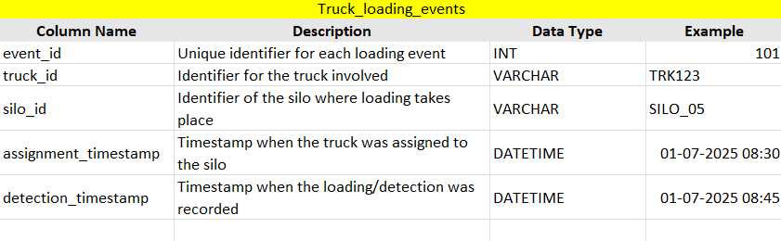
Data Dictionary
Truck Loading Events

Slide 7
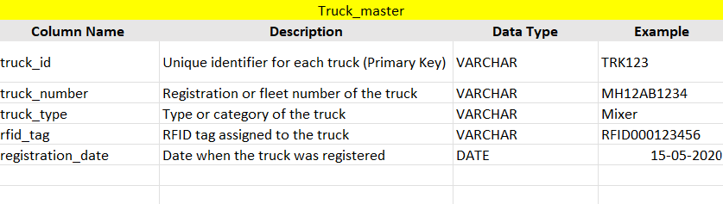
Data Dictionary
Truck Master

Slide 8
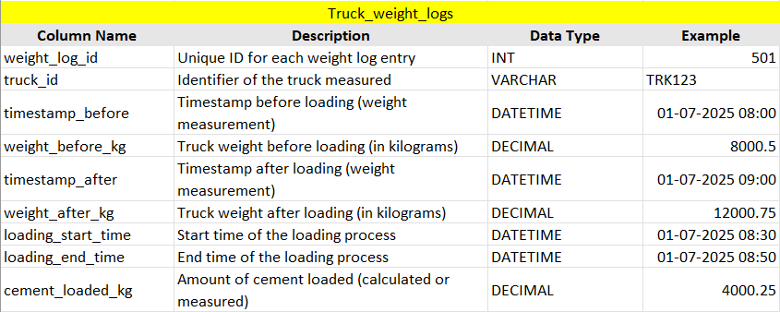
Data Dictionary
Truck Weight Logs

Slide 9
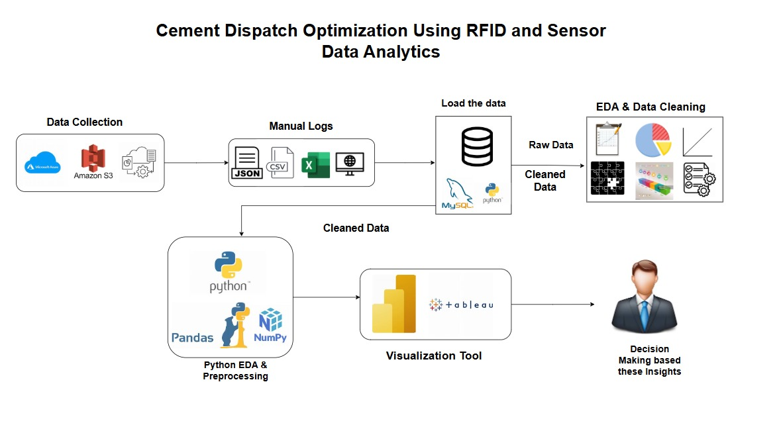
Project Architecture - Data Flow Diagram

Slide 10
Data Collection and Understanding
The project leverages weighbridge and dispatch log data from the cement manufacturing supply chain. Data was collected from multiple sources, including weighbridge records for load measurements and system logs for truck registration, assignments, and timestamps.
The dataset contains key attributes such as truck ID, timestamps (loading start/end, weigh-in, weigh-out), weight before and after loading, and cement loaded per trip, providing a complete view of each dispatch cycle.
Understanding the data involved identifying relationships between tables, validating consistency (e.g., cement_loaded = weight_after – weight_before), and ensuring completeness across dispatch events. Preliminary checks revealed missing values, outliers in loading time, and weight mismatches, which were addressed during preprocessing.
This foundation of clean, well-understood data ensures accurate analysis, KPI development, and actionable business insights for optimizing the dispatch process.

Slide 11
Data Information
Data Type: Structured (transactional dispatch logs, timestamps, weights, IDs)
Key Attributes:
Truck Details: truck_id, truck_number, truck_type, registration_date
Dispatch Events: event_id, assignment_timestamp, detection_timestamp
Weight & Loading: weight_before_kg, weight_after_kg, cement_loaded_kg, loading_start_time, loading_end_time
Volume: Thousands of dispatch records covering multiple trips daily
Granularity: Trip-level data capturing the complete cycle (loading → weigh-out → gate-out)
Format: Combination of CSV/Excel logs and system-generated dispatch tables

Slide 12
Technical Stacks
Data Sources & Storage
Weighbridge Data – Weight before/after loading
Dispatch Logs – Truck details, timestamps, assignments
Excel/CSV Files – Primary format for raw data storage
SQL Database – For structured queries and KPI generation
Data Processing & Analysis
Python (Pandas, NumPy) – Data cleaning, preprocessing, KPI calculations
SQL – Data extraction, filtering, joins, aggregations
Jupyter Notebook / Google Colab – Exploratory Data Analysis (EDA)
Visualization & Reporting
Power BI – Interactive dashboards, real-time KPI tracking
Presentation & Documentation
MS PowerPoint – Project reporting & presentation
MS Excel – Data summaries and supporting documentation

Slide 13
Exploratory Data Analysis [EDA]
Statistical Insights
Business Insights
Average truck turnaround time = X hrs, with outliers up to Z hrs.
Mean loading time ≈ 25 mins, with some extreme cases > 60 mins.
Cement load per trip averages 15 tons ± 3 tons, showing load imbalance.
Dispatch activity peaks between 10 AM – 2 PM, lowest in late evening.
2% weight mismatches detected between weighbridge and sensor records.
Prolonged turnaround highlights process bottlenecks at gates/queues.
Outlier loading times suggest downtime or underperforming bays.
Variability in load utilization causes inefficient fleet usage & extra trips.
Peak-hour congestion indicates poor scheduling and uneven resource use.
Weight mismatches raise compliance and revenue leakage risks.
Notes:
EDA is used for seeing what the data can tell us before the modeling task.
Change

Slide 14
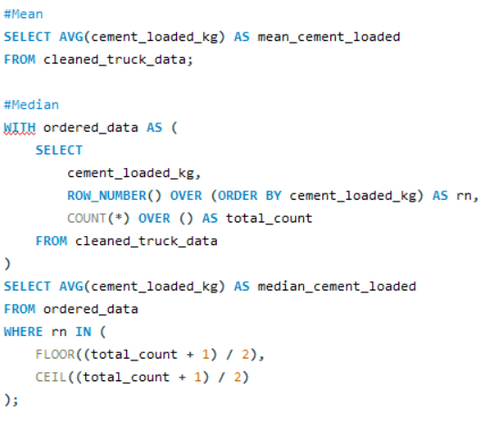
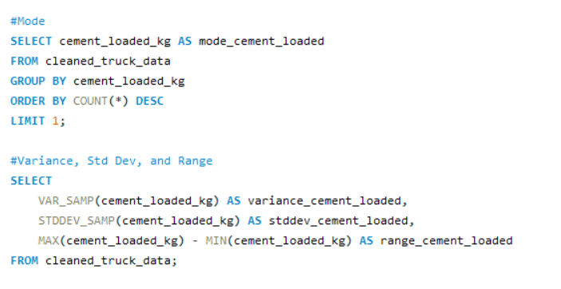
Exploratory Data Analysis [EDA] in SQL
Notes:
Keep observations

Slide 15
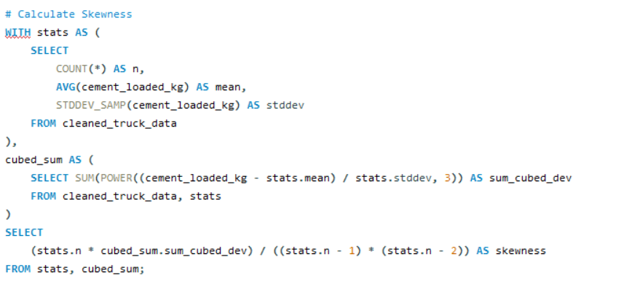
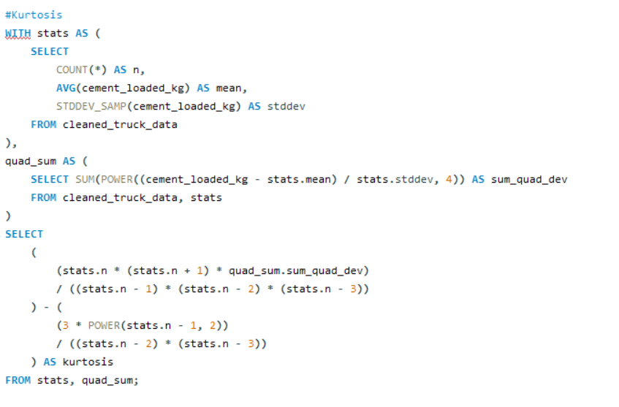
Exploratory Data Analysis [EDA] in SQL
Notes:
Keep observations

Slide 16
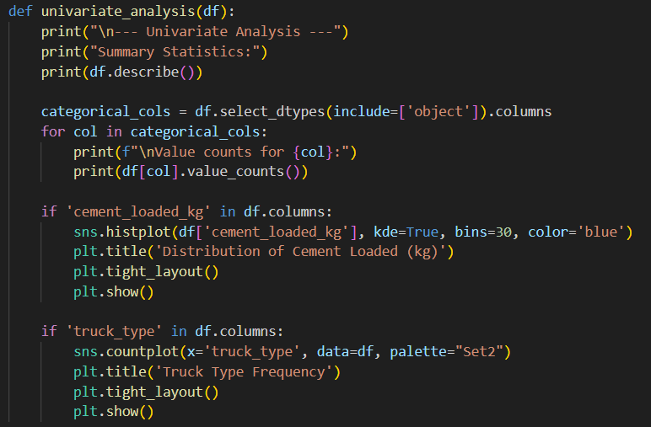
Exploratory Data Analysis [EDA] in Python
Notes:
Keep observations

Slide 17
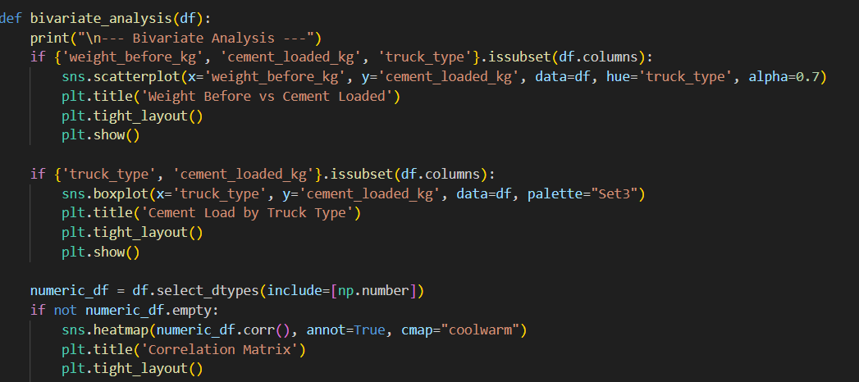
Exploratory Data Analysis [EDA] in Python
Notes:
Keep observations

Slide 18
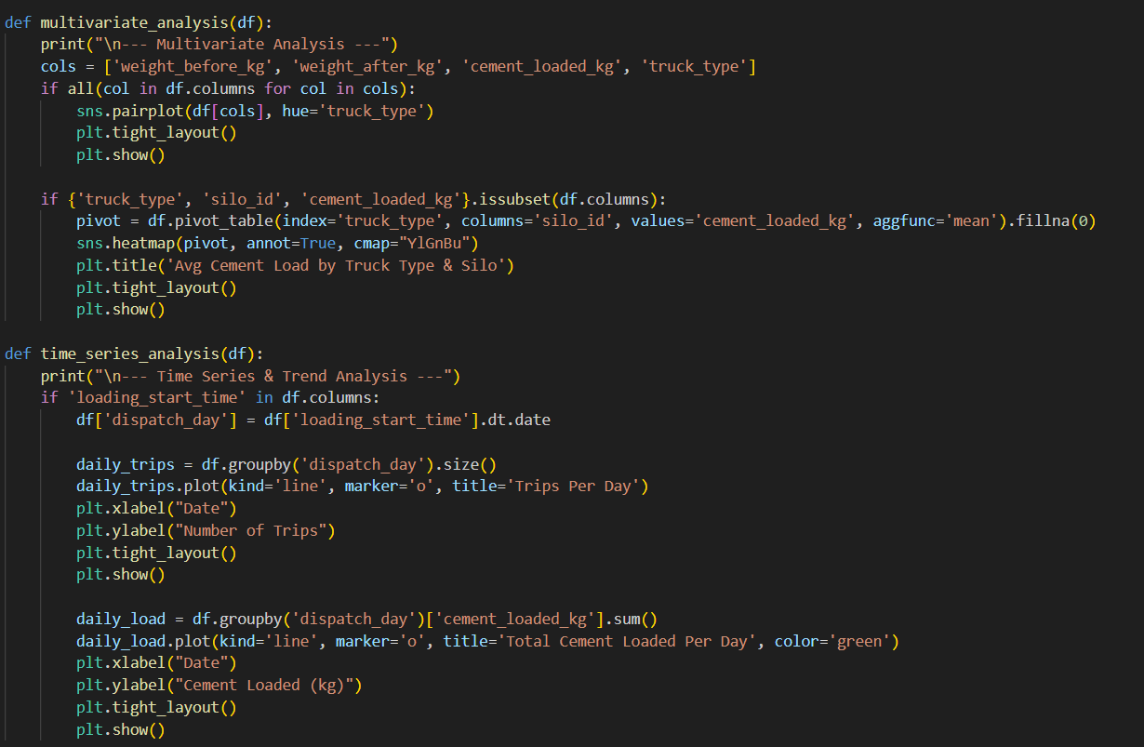
Exploratory Data Analysis [EDA] in Python
Notes:
Keep observations

Slide 19
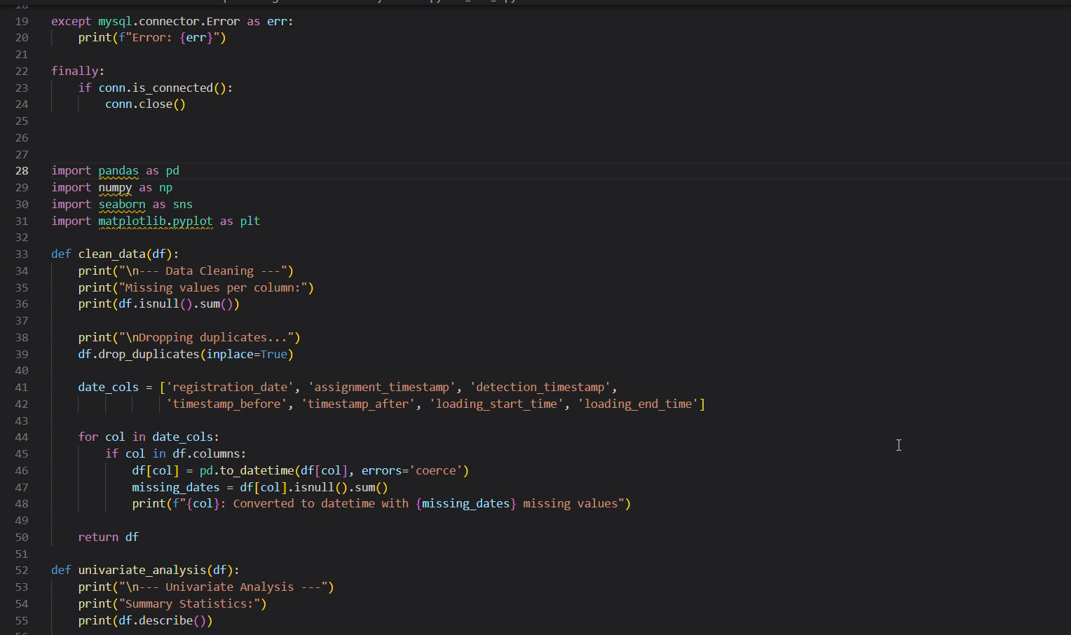
Exploratory Data Analysis [EDA] in Python
Notes:
Keep observations

Slide 20
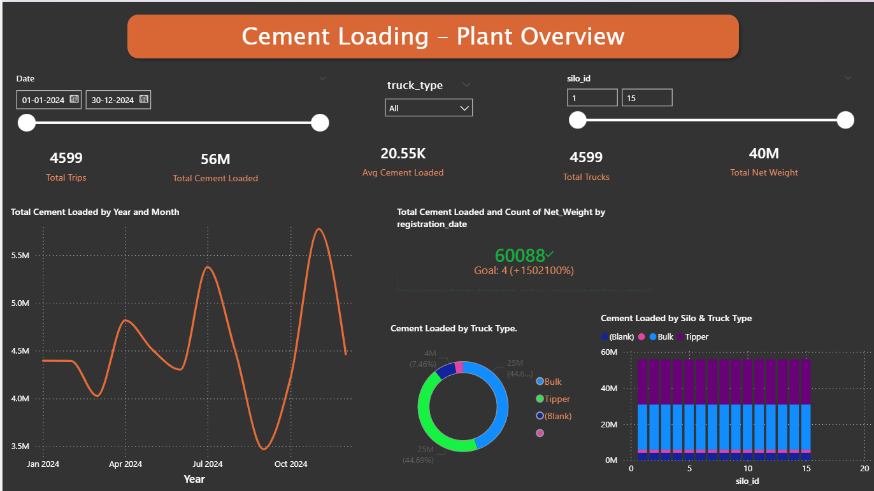
Data Visualization in Power BI
Notes:
Add graphical

Slide 21
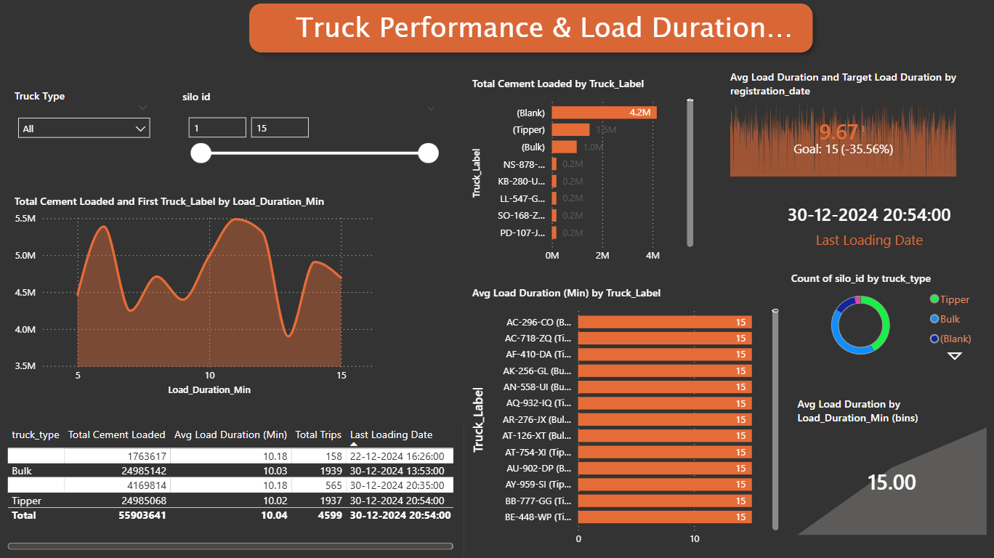
Data Visualization in Power BI
Notes:
Add graphical

Slide 22
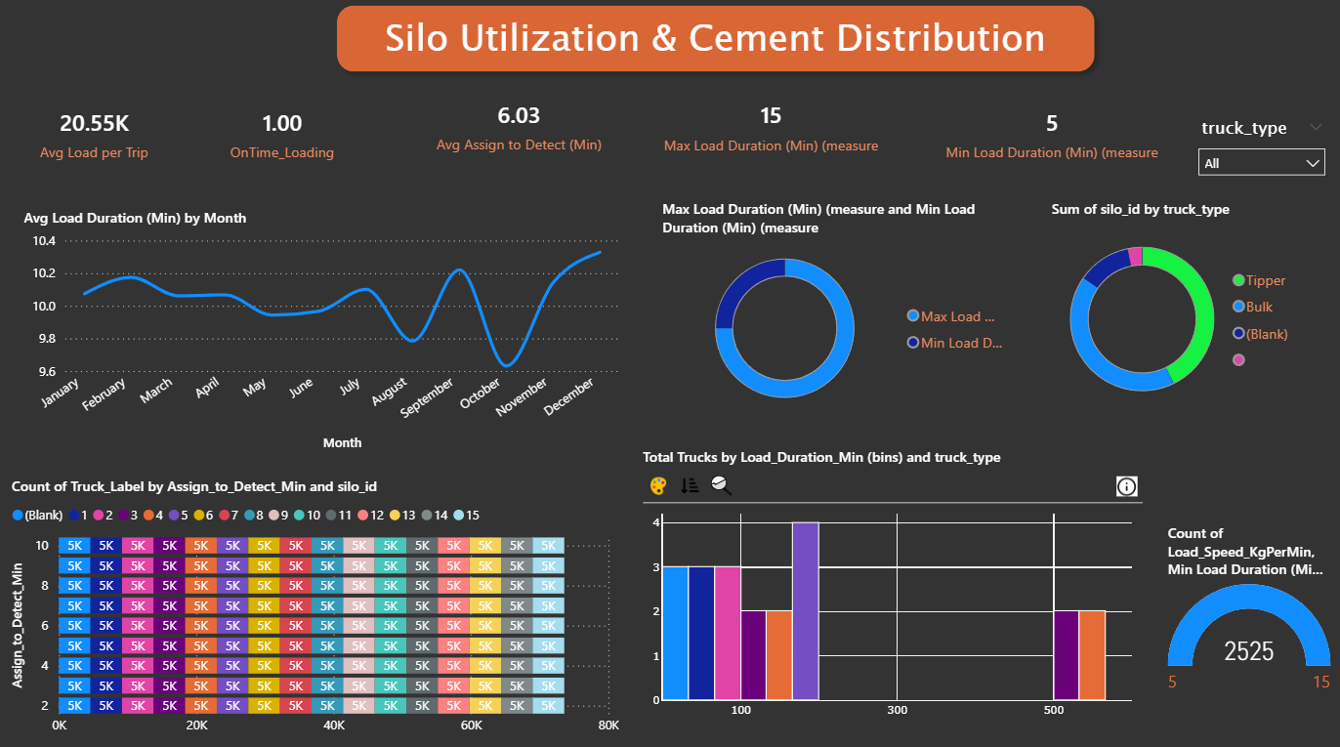
Data Visualization in Power BI
Notes:
Add graphical

Slide 23
Data preprocessing
Data Cleaning – Removed duplicates, handled missing values, and corrected inconsistent formats (timestamps, truck IDs).
Data Integration – Merged weighbridge data and dispatch log data into a single dataset.
Data Transformation – Standardized units (kg, tons) and calculated derived fields (cement loaded = weight_after – weight_before, turnaround time).
Outlier Detection – Identified abnormal loading times, weight mismatches, and extreme turnaround durations.
Feature Engineering – Created new KPIs (average loading time, trips per truck, idle time, peak hours) for analysis and visualization.

Slide 24
Challenges
Data Quality Issues – Missing values, duplicate records, and inconsistent timestamps in dispatch logs.
Integration Complexity – Combining weighbridge and dispatch log data for a complete trip view.
Outliers & Anomalies – Abnormally high/low turnaround times and weight mismatches impacting accuracy.
Limited Data Coverage – Gaps in records due to manual entry errors or missing logs.
Operational Dependency – Reliance on accurate and timely data entry by staff and system logs.

Slide 25
Conclusion
The analysis of weighbridge and dispatch log data demonstrates significant opportunities to optimize cement dispatch operations. The project identified bottlenecks in truck loading, turnaround times, and overall fleet utilization, highlighting areas for operational improvement. By developing key performance indicators (KPIs) and interactive dashboards, data-driven monitoring and actionable insights are now possible, enabling informed decision-making. Implementing the recommendations from this study can reduce delays, improve on-time deliveries, and lower operational costs, ultimately enhancing the efficiency and reliability of the supply chain. Additionally, the framework is scalable and can be extended to other plants or logistics processes, supporting continuous improvement and future optimization initiatives.

Slide 26


